Slide 1

Placement Management System
Bhujbal Knowledge City
Symbiosis Skill & Professional University (SSPU)
Presented by:
Ajay Kedar
Shubhan Suryawanshi
Ravindra Khadangale
Chaitanya Mate
Gaurav Kapade
Guided By :
Prof. Vinaya Kulkarni

Slide 2
contents:-
Bhujbal Knowledge City
Symbiosis Skill & Professional University (SSPU)
Introduction.
Operating Environment.
Models
Problem Statement.
Objectives scope of project requirement.
Overview.
Design.
Conclusion

Slide 3
INTRODUCTION
Bhujbal Knowledge City
Symbiosis Skill & Professional University (SSPU)
"Effortless Recruitment, Endless Possibilities"
Say hello to the Placement Management System (PMS) –
Your trusted partner in managing job drives, smooth, sophisticated, enjoyable placements drive, and guiding students towards a brighter future.

Slide 4
Operating Environment
Bhujbal Knowledge City
Symbiosis Skill & Professional University (SSPU)
1. Software Requirements:
Technology : Open Source.
Front end : Html, CSS, JavaScript, bootstrap.
Database :SQL Server, MySQL.
Back end : C#.
Frame work : ASP.Net.
Operating system : WINDOWS.
2. Tool & Technologies Used:
SQL Server
Visual Studio
3

Slide 5
Models
Bhujbal Knowledge City
Symbiosis Skill & Professional University (SSPU)
Student Dashboard
College Admin Profile
HR Dashboard

Slide 6
Bhujbal Knowledge City
Symbiosis Skill & Professional University (SSPU)
Problem Statement
The current campus placement process is inefficient and disorganized, with students struggling to find relevant job opportunities, recruiters facing difficulties in managing job postings and applications, and administrators lacking centralized tools for coordination and reporting. The Placement Drive Portal aims to address these issues by creating a centralized, web-based platform that streamlines job searches, application management, communication, and data analysis, benefiting students, recruiters, and administrators alike.

Slide 7
Objectives Scope Here's what we're aiming for:
Bhujbal Knowledge City
Symbiosis Skill & Professional University (SSPU)
The objective of the Placement Drive Portal is to streamline and enhance the campus placement process by providing a centralized, user-friendly platform.
This portal will:- Facilitate efficient job posting and application management.
- Improve communication between students, recruiters, and administrators through automated notifications.
- Enable real-time tracking of job applications.- Provide comprehensive reporting and analytics tools for informed decision-making.
- Ensure secure, role-based access to different features for all users involved.

Slide 8
Overview
Bhujbal Knowledge City
Symbiosis Skill & Professional University (SSPU)

Slide 9
Student Dashboard.
Bhujbal Knowledge City
Symbiosis Skill & Professional University (SSPU)
Introduction: To provide an overview of the student model used in the placement drive project, detailing the process from registration to applying for jobs.
Database DesignUser Flow: Registration, Login, Profile ViewCompany Details & Application Process
The student model in the placement drive project covers the entire journey from registration to job application.It ensures that students have a smooth and streamlined experience, while administrators have the tools needed to manage the process.

Slide 10
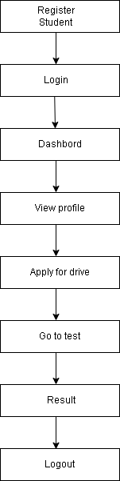
Bhujbal Knowledge City
Symbiosis Skill & Professional University (SSPU)

Slide 11
College Admin Profile.
Bhujbal Knowledge City
Symbiosis Skill & Professional University (SSPU)
Admin Login: A login page for college admins using Bootstrap for styling.
Student and Company Management: Pages to manage student and company information, including registration, displaying data, and editing details.
Placement Drives: Sections for capturing and displaying upcoming company drives, with fields like CompanyName, DriveDate, Location, Position, and Vacancy.
Dashboard Pages: Separate dashboard pages for college admins and students, with features like displaying student profiles, upcoming drives, and applying for drives.
Registration Pages: For students and companies, including validation and password management features.

Slide 12
Bhujbal Knowledge City
Symbiosis Skill & Professional University (SSPU)
Index.aspx: Navigation buttons for Student, College, and About sections.
Admin Login Page: Admins log in using credentials to access the dashboard.
Student Details.aspx: Displays student details fetched from the database using the UserID. Includes a delete button for removing students.
CollageDash.aspx: Displays student data and other details. It also includes a section for adding company drive details and a section for upcoming drives.
Apply.aspx: Allows students to apply for drives by fetching data from the Company table.

Slide 13
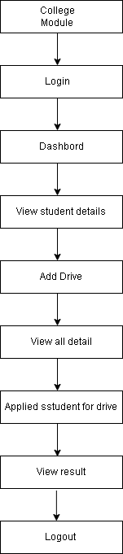
Bhujbal Knowledge City
Symbiosis Skill & Professional University (SSPU)
admin flow diagram

Slide 14
HR Platform.
Bhujbal Knowledge City
Symbiosis Skill & Professional University (SSPU)
1. Home.aspx :
- Home Page; Redirections By Nav
2. ViewJobs.aspx :
- Create the Job
- View / Edit the Posted Job
3. SetTest.aspx
- Set the Random No and Time(Min)
- Set/Manage the Test by Editing Questions And Answers
4. ViewTestScores.aspx
- Retrieve score from StudentTests and show it.

Slide 15
Aptitude Platform.
Bhujbal Knowledge City
Symbiosis Skill & Professional University (SSPU)
StartTest.aspx :
- Save job and name in Session; redirect to TakeTest.aspx.
2. TakeTest.aspx :
- Fetch questions based on JobId and RandomNo.
- Set timer from ExamTimer.
- Save answers in StudentAnswers; calculate score.
- Redirect to TestResult.aspx.
3. TestResult.aspx
- Retrieve score from StudentTests and show it.

Slide 16
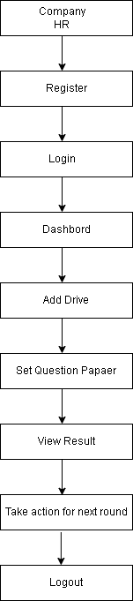
Bhujbal Knowledge City
Symbiosis Skill & Professional University (SSPU)
Hr flow diagram

Slide 17
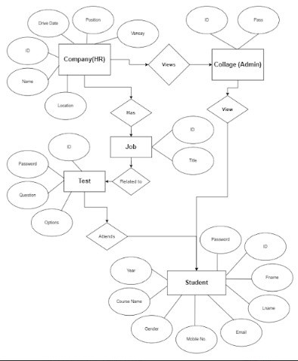
Bhujbal Knowledge City
Symbiosis Skill & Professional University (SSPU)
Er model

Slide 18
Bhujbal Knowledge City
Symbiosis Skill & Professional University (SSPU)
Design

Slide 19
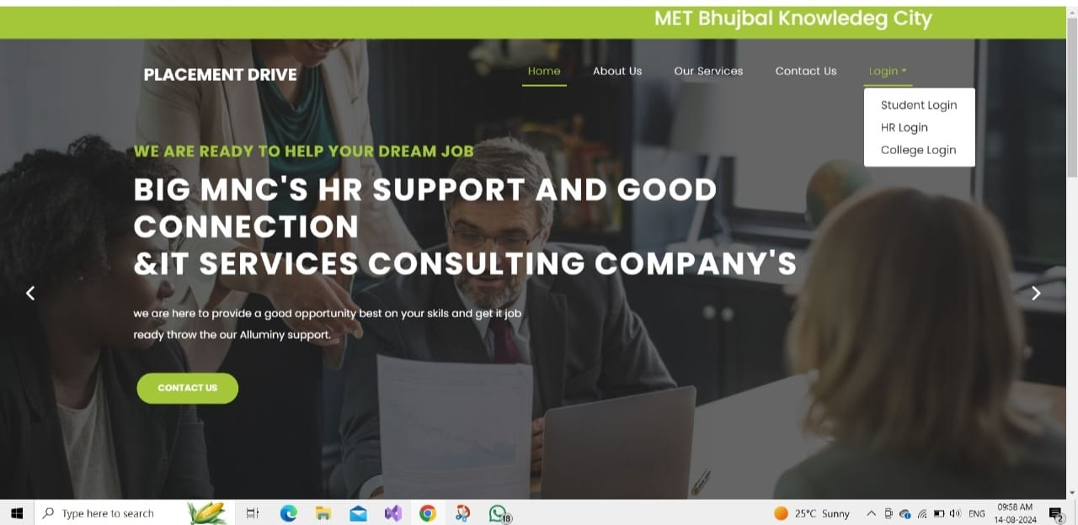
Bhujbal Knowledge City
Symbiosis Skill & Professional University (SSPU)

Slide 20
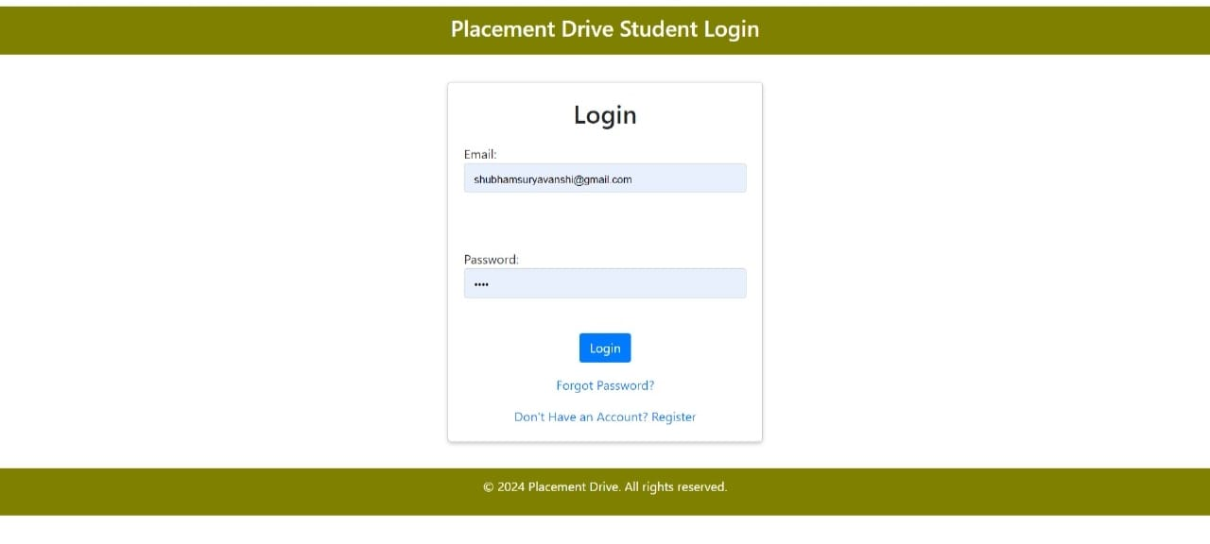
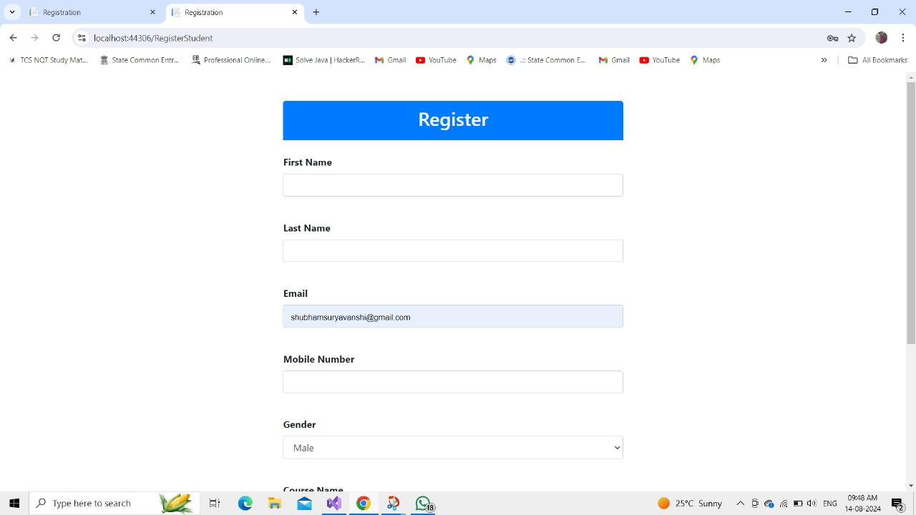
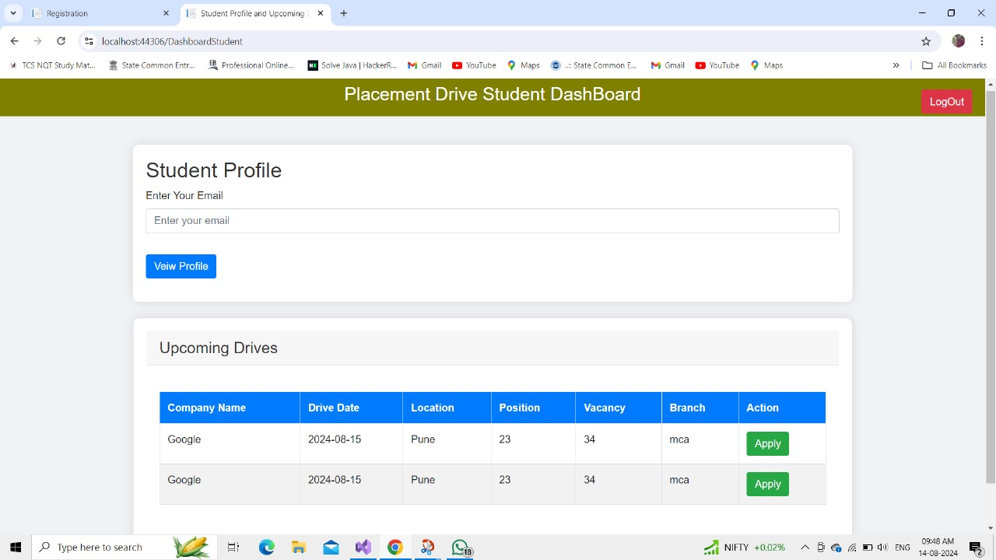
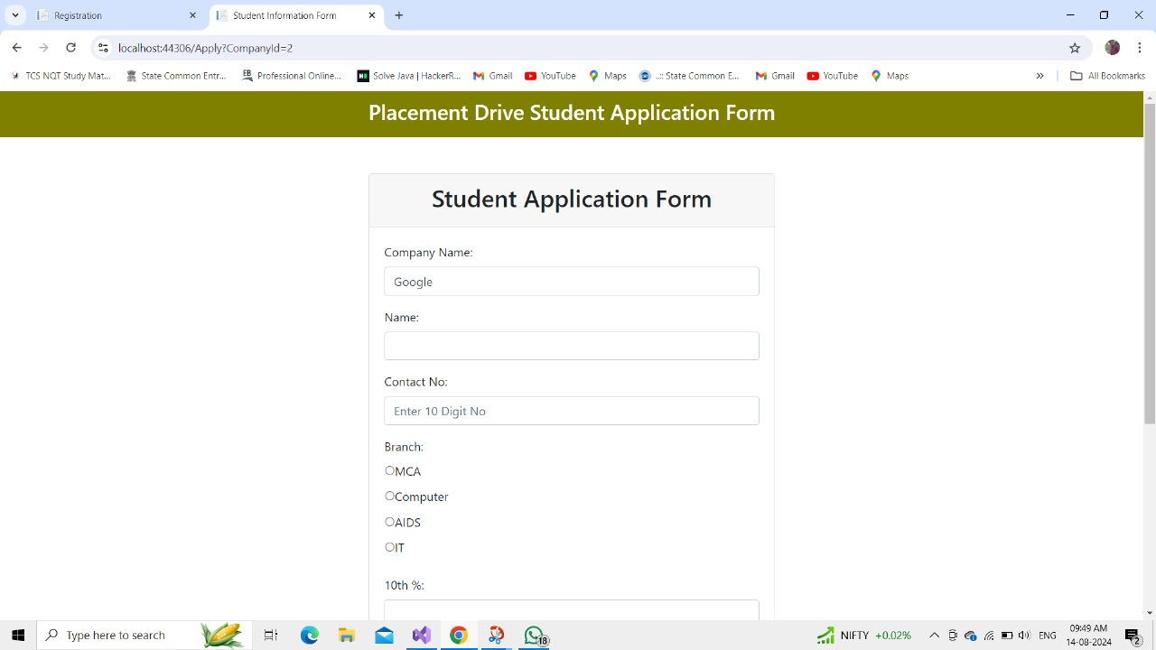
Student Login Design
Bhujbal Knowledge City
Symbiosis Skill & Professional University (SSPU)

Slide 21
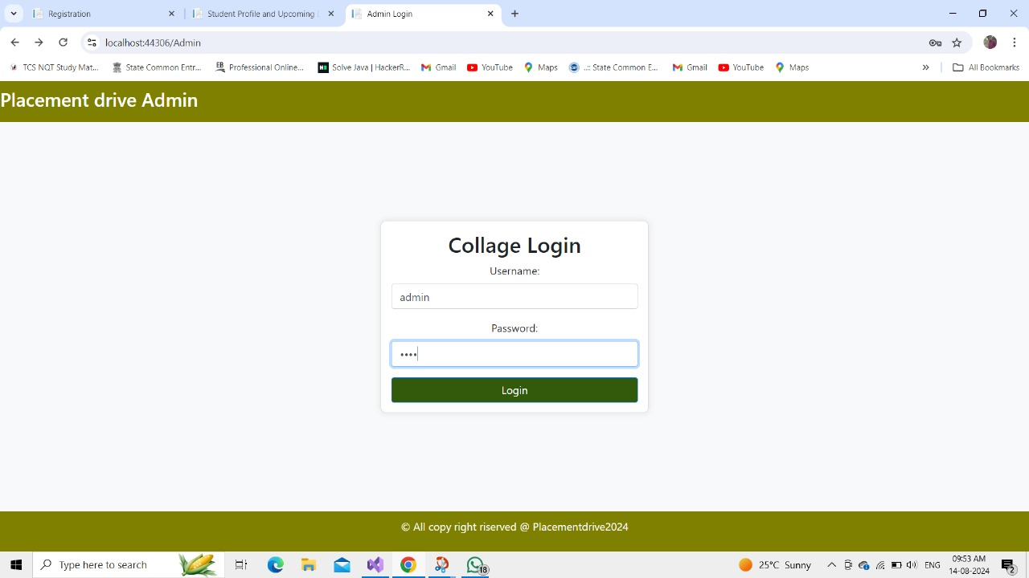
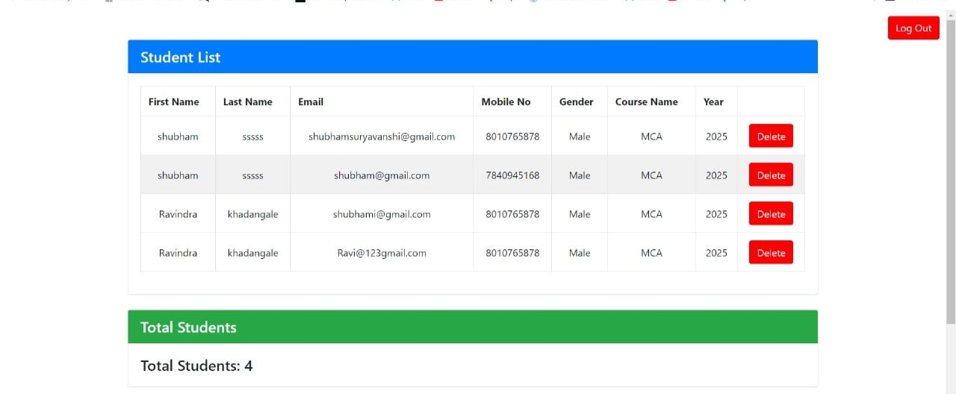
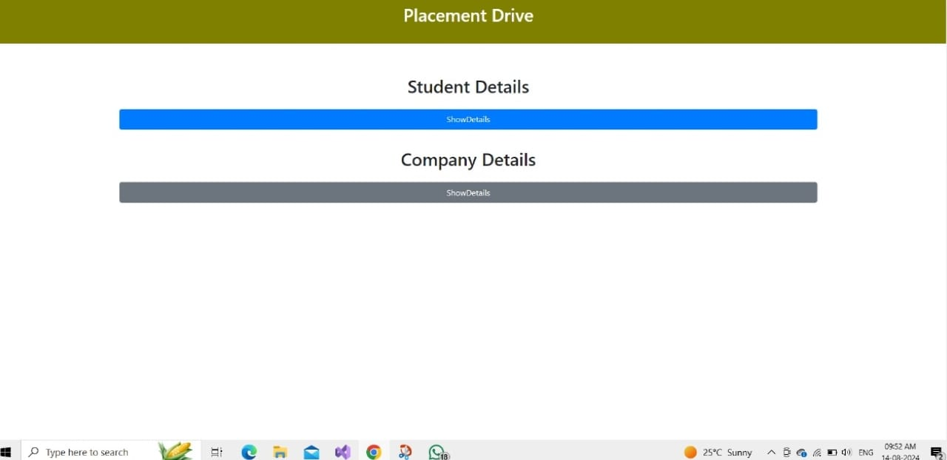
College Admin Design
Bhujbal Knowledge City
Symbiosis Skill & Professional University (SSPU)

Slide 22
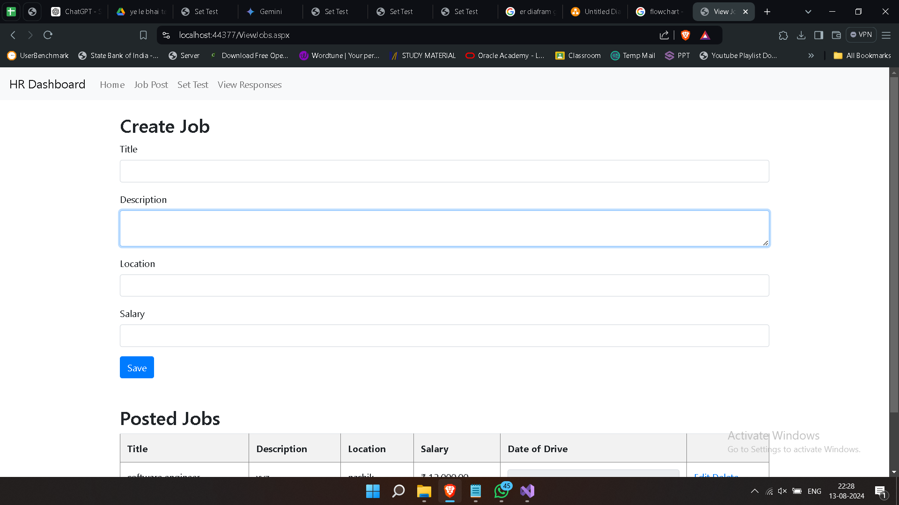
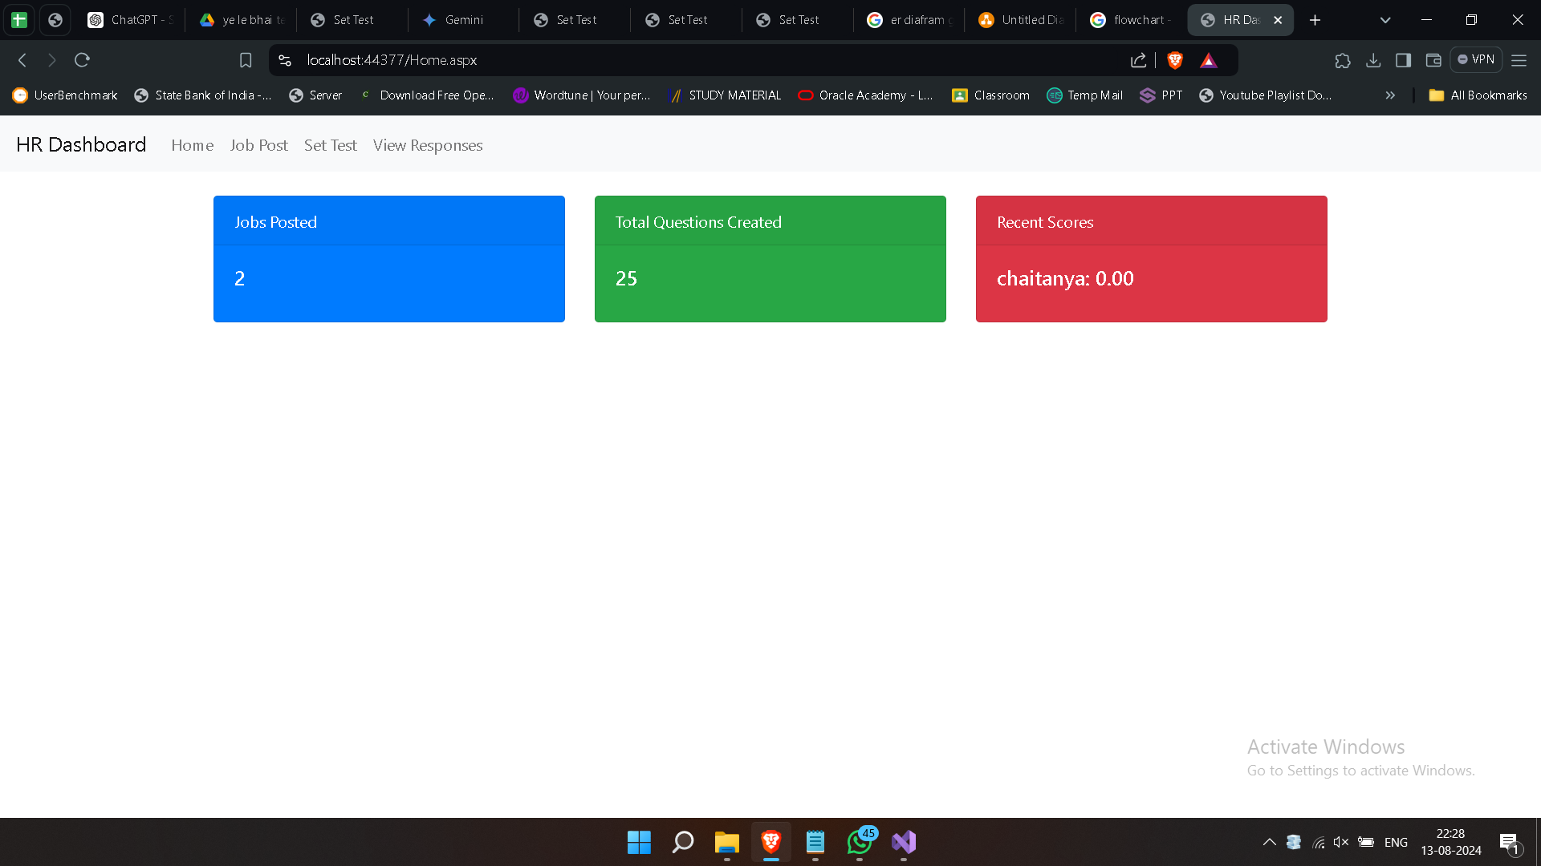
Bhujbal Knowledge City
Symbiosis Skill & Professional University (SSPU)
HR Login Design

Slide 23
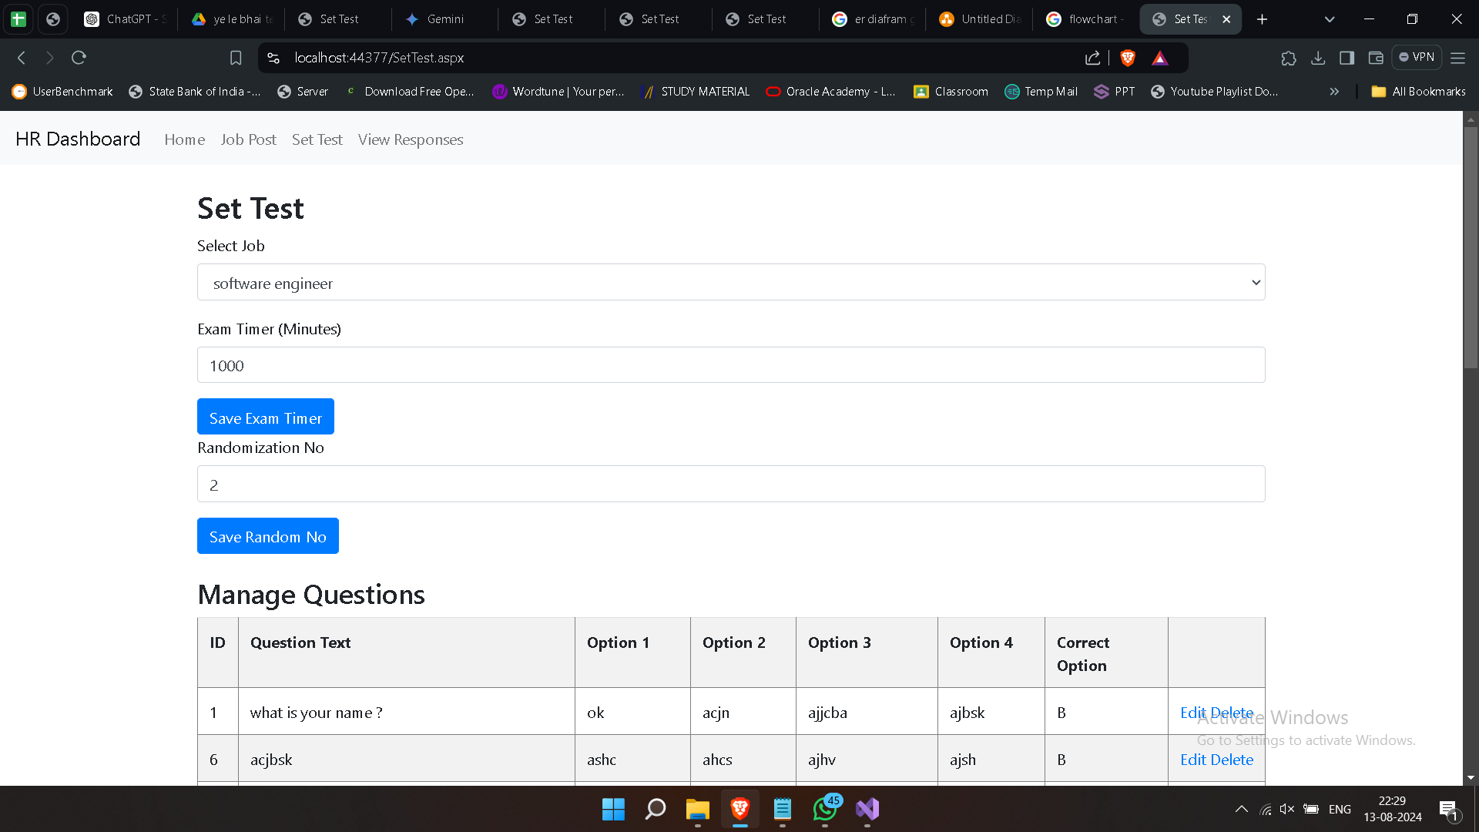
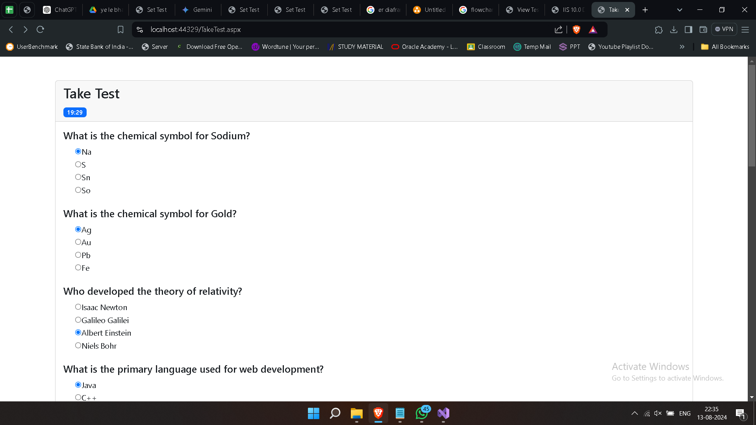
Bhujbal Knowledge City
Symbiosis Skill & Professional University (SSPU)

Slide 24
Conclusion
Bhujbal Knowledge City
Symbiosis Skill & Professional University (SSPU)
So, let's get excited about making our PMS and better for all of us. Together, we can build a future that's bright, sustainable, and full of possibilities!

Slide 25
THANK YOU !!
Bhujbal Knowledge City
Symbiosis Skill & Professional University (SSPU)

